Slide 1
Home Owl
Autonomous Security Robot
Samantha Buckle
Dylan Dauz
Sameeh Olipani
Sheldon Peters
Notes:
sameeh

Slide 2
Problem
Homes, businesses, and facilities become vulnerable at night to break-ins or intrusions
On average, 3,062 burglaries happen in the U.S. every day
Full security systems are:
Semi-permanent
Costly
Can take time to install
Notes:
sameeh

Slide 3
Project Goals
This project aims to design and build a robot for use in the monitoring of indoor spaces
Robot will be capable of:
Autonomous navigation of a building or room without the need for human control
Utilize sensors to detect loud noises or the presence of a person
Flash lights and play an alarm sound when disturbance is detected
Get signal from remote control to turn the system on and off
Notes:
sheldon

Slide 4
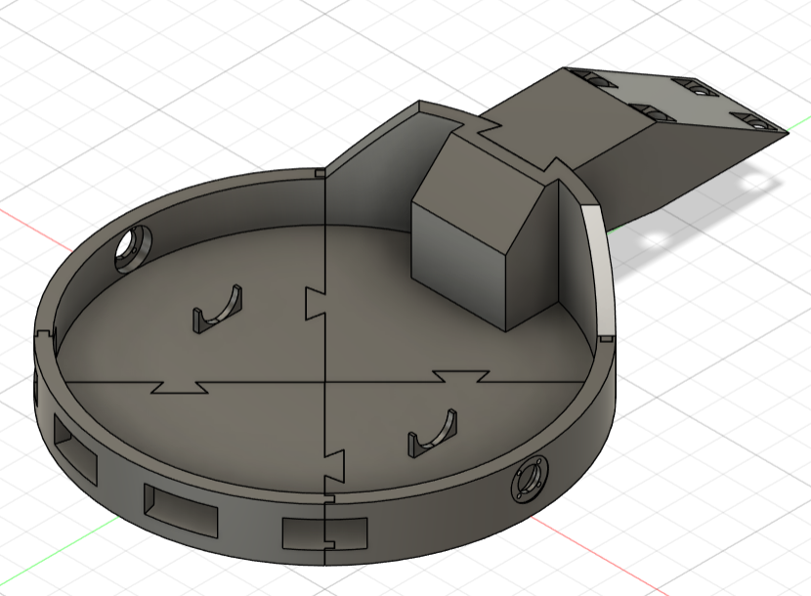
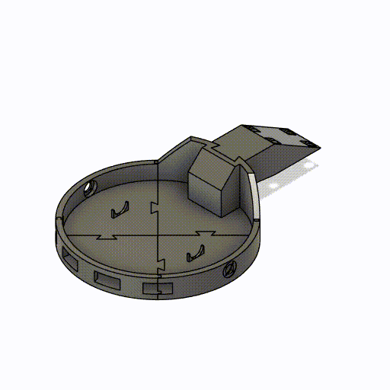
Prototype
Notes:
dylan

Slide 5
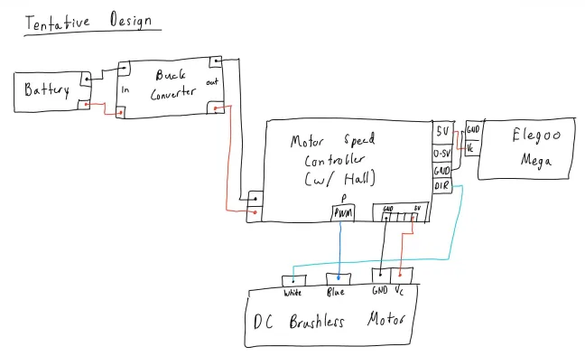
Wiring Diagram
Notes:
sheldon

Slide 6
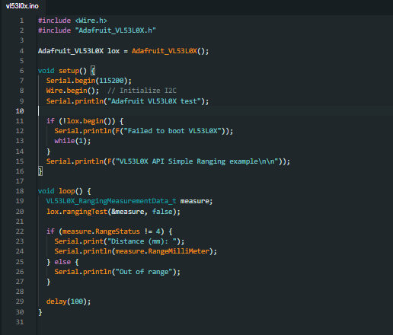
Parts Testing
VL53L0X Time of Flight Sensor
Install Adafruit_VL53L0X package and dependencies on Arduino IDE
All of them work
Note that pins GPI01 and XSHUT pins were not used in testing
Notes:
sheldon

Slide 7
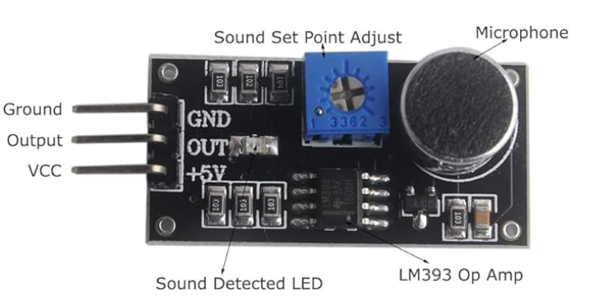
Parts Testing
LM393 Sound Sensor
All of them worked
Potentiometer adjusts the sound sensitivity of what it picks up
Notes:
samantha

Slide 8
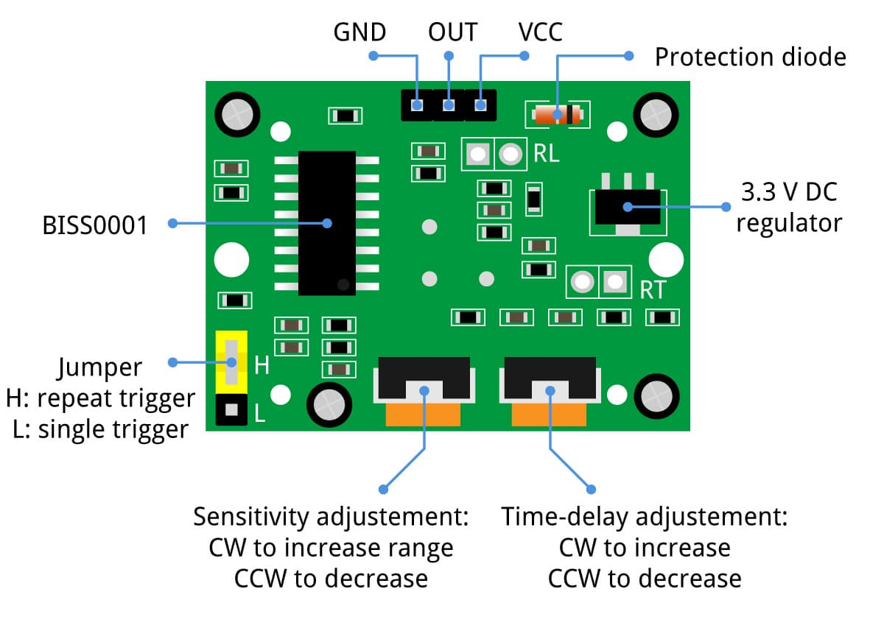
Parts Testing
HC SR501 Passive Infrared Sensor
All of them worked
Sensitivity Adjustment: What it counts as a “movement”
Time-Delay Adjust: How long before motion is no longer registered
Jumper:
Low: Constant motion will cause single trigger
High: Constant motion will cause series
Notes:
samantha

Slide 9
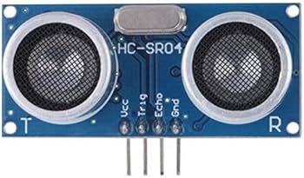
Parts Testing
HC SR04 Ultrasonic Sensor
All of them worked
Worked with these multiple times
Notes:
samantha

Slide 10
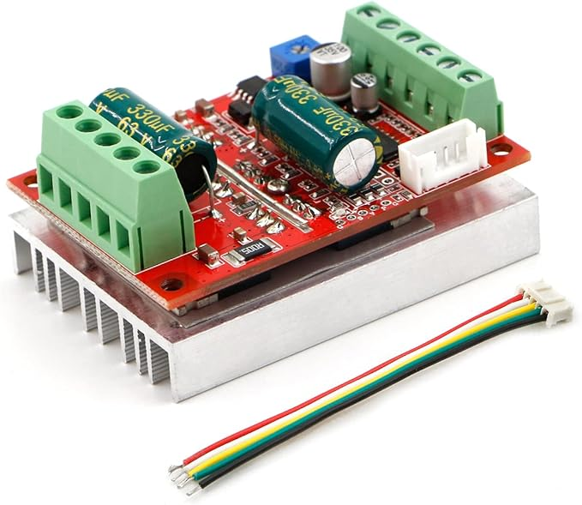
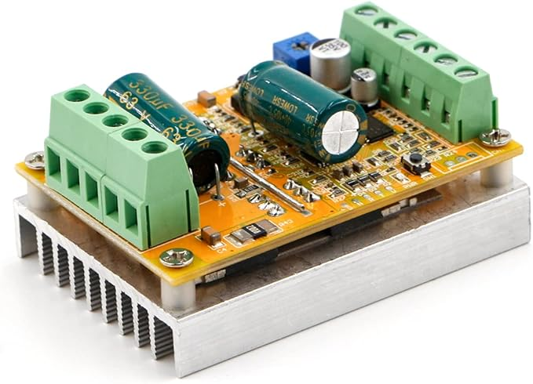
Next Steps
Printing the chassis of the robot
Construction of putting multiple 3D printed parts together
Testing components compatibility with chassis
Testing with motor and motor controller
We got the wrong motor controller..?
Questions about that
Last steps for lab access
Notes:
dylan

